Slide 1
Differential Drive Mobile Robot Final Project
By: Audrey Warrene and Leo Doak

Slide 2
Outline
DDR Overview (Slide 3-4)
Slide 3: Review of Project 1
Slide 4: Real-Life Scenarios
Implementation (Old) (Slides 5-7)
Slide 7: Example
Animations (Slide 8)
Implementation (New) (Slides 9-26)
Slides 10-19: PID Controllers
Slides 20-27: MPC Controller
Inputs/Outputs (Slide 28)
Conclusion – Project 1 (Slide 29)
Conclusion – Project 2 (Slide 30)
Citations (Slide 31)

Slide 3
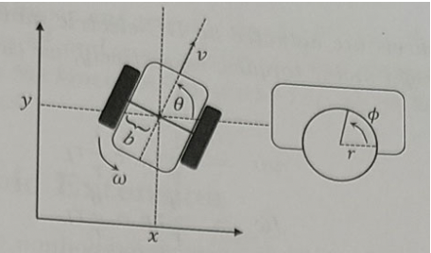
Differential Drive Robot Review
A DDR is a mobile robot system that controls its movement through the differential speed and direction of its two drive wheels.
Known for its simplicity and maneuverability.
Our project originally focused on seeing how altering the acceleration of each individual wheel on our robot affects the velocity, heading and position of our system.

Slide 4
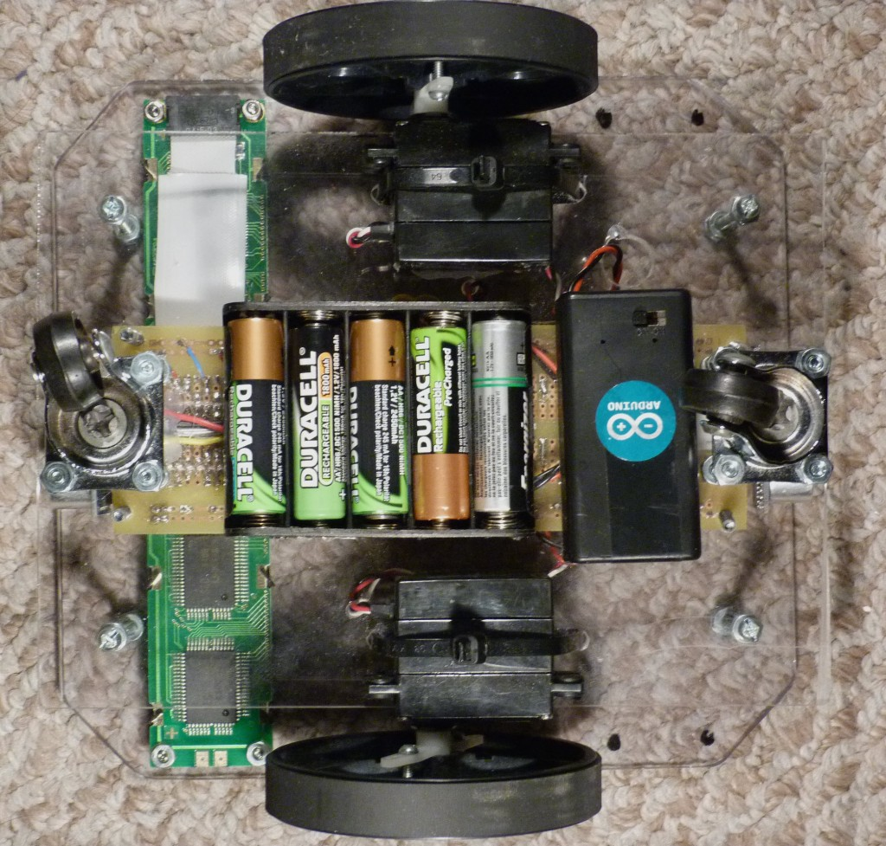
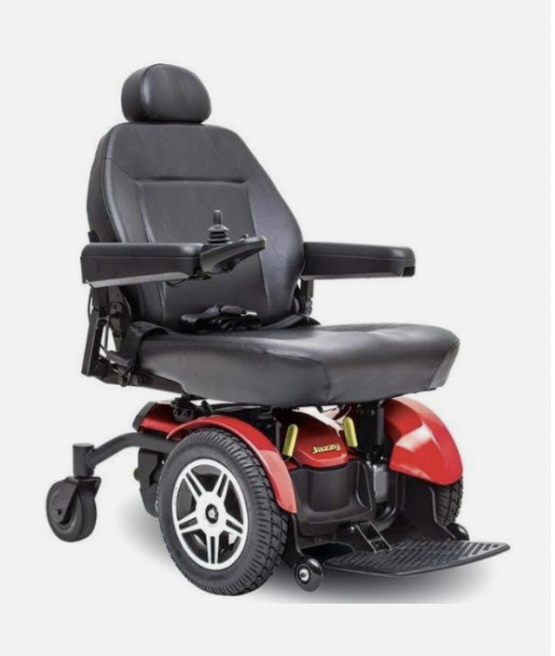
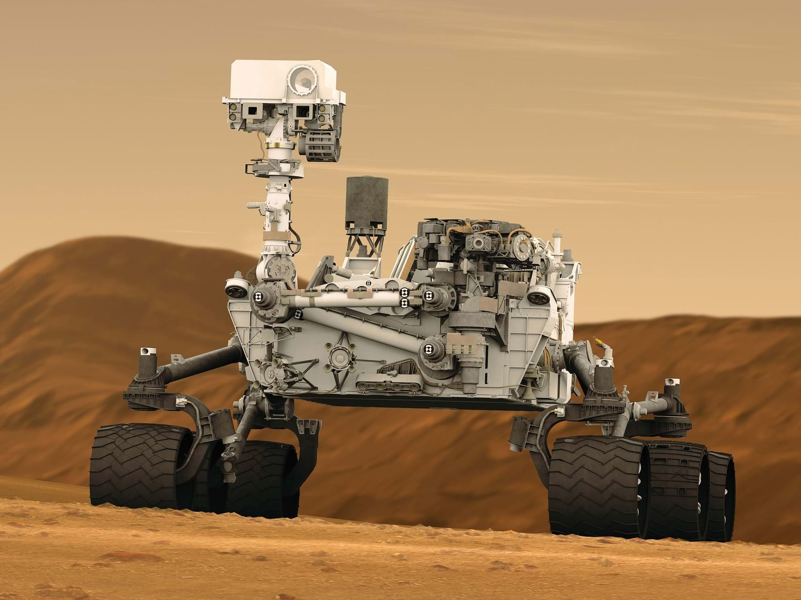
Real-Life Scenarios
Can be used in many fields:
Warehouse Automation → Helps deliver goods to/from different sections
Agricultural Robots → For crop monitoring and maintenance
Space Exploration
Hazardous environment exploration
Educational Purposes
AND MORE!
[6]
[8]
[7]
[13] and [14]

Slide 5
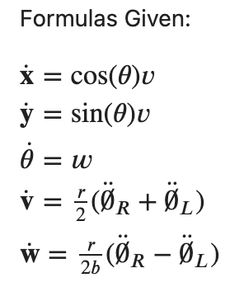
What each variable is:
x, y: the horizontal and vertical positions of the center of the robot
Θ̇: the angular position (heading) of the robot
𝑣: the forward velocity
𝑤: the angular velocity
𝑟: radius of the wheel
𝑏: distance of each wheel to the center of the robot
theta(l) and theta(r): Angular accelerations of left and right wheel, also the system inputs
Predetermined Values:
→ 𝑟 : .02 meters
→ 𝑏 : .05 meters
Notes:
Set all the variables but r,b and the heading to zero. Set the heading to pi/4

Slide 6
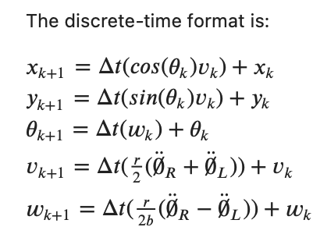
Discrete Time Format
Notes:
Screenshot of the latex code in the kaggle document

Slide 7
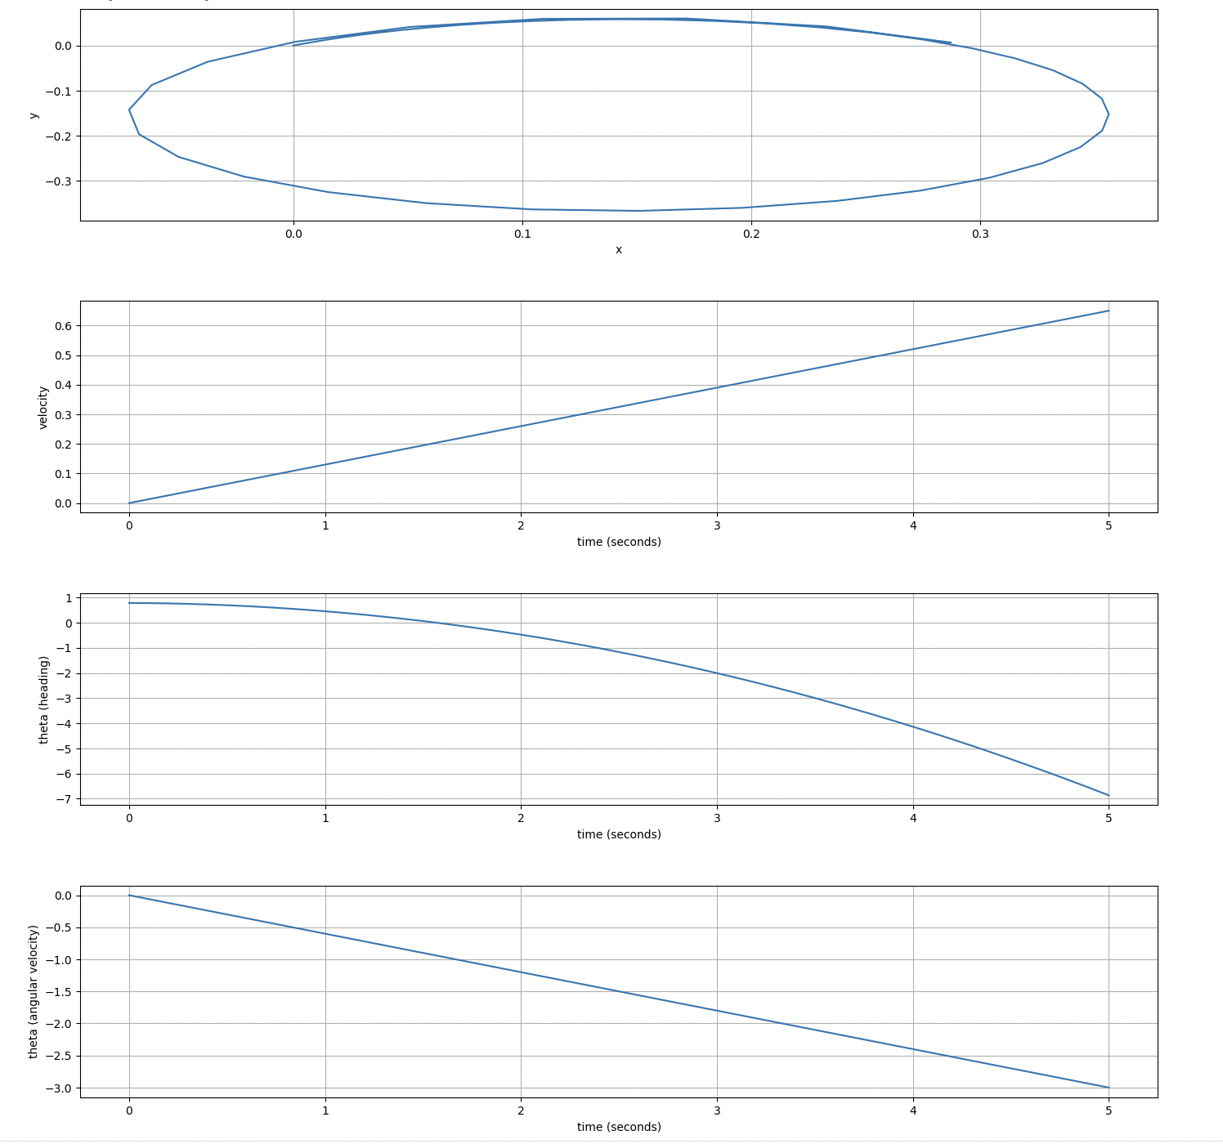
Original Implementation – Example
Hypothesis –
left wheel having higher value than right wheel

Slide 8
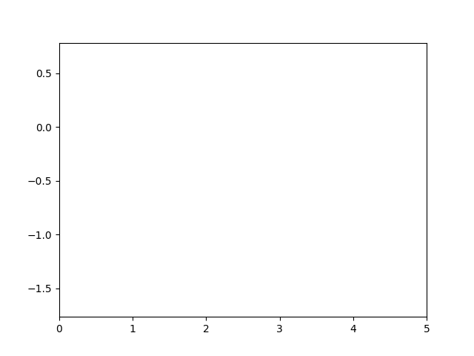
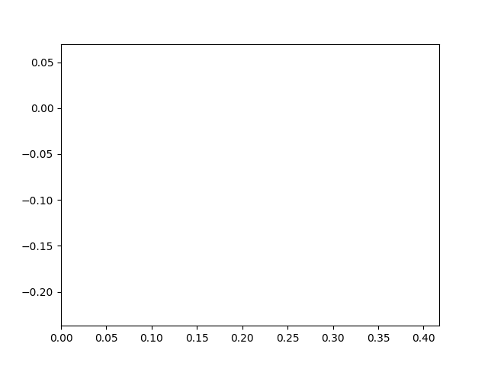
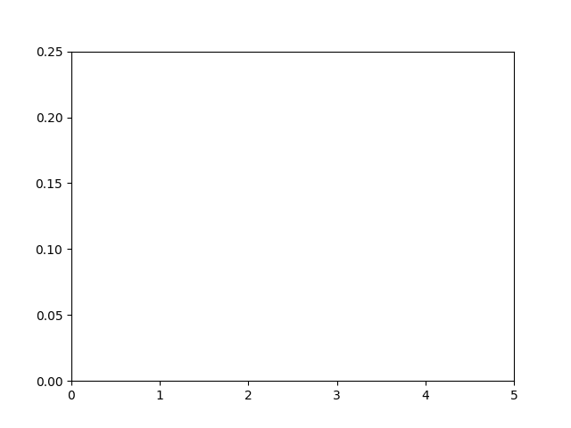
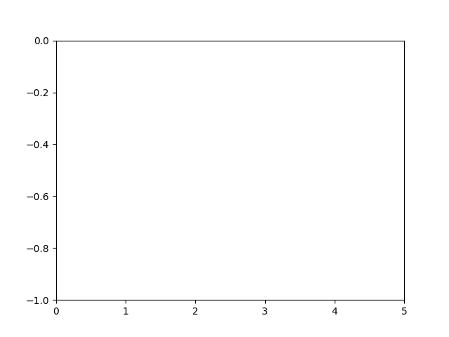
Animations
Time List VS.
Heading List
X_List
VS.
Y_List
Right Acceleration = 2
Left acceleration = 3
Time List VS.
V_List
Time List VS.
Ang_Vel
List

Slide 9
Implementation of PID and MPC controllers

Slide 10
PID Controllers Implementation

Slide 11
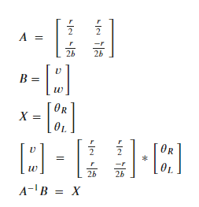
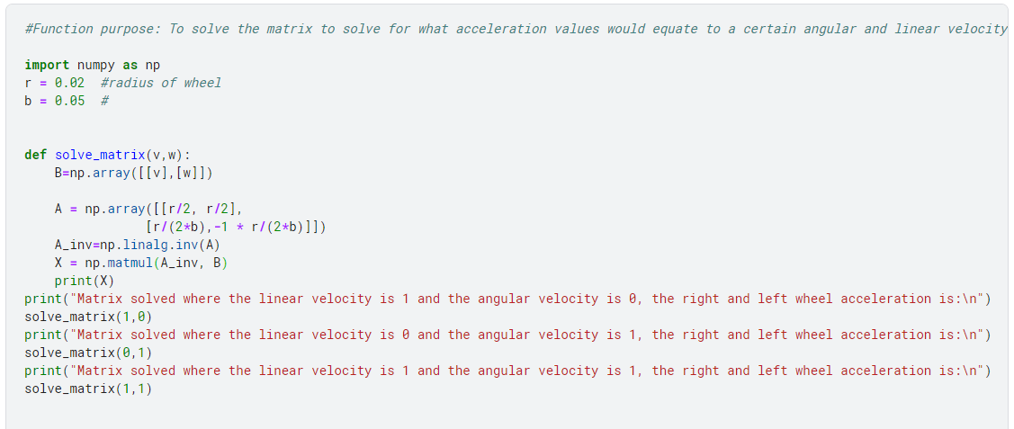
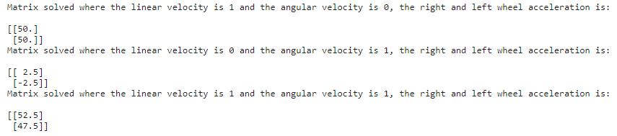
Solving the Matrix:
Notes:
We had to solve the matrix in order to see what acceleration values would correlate to a certain velocity and angular velocity

Slide 12
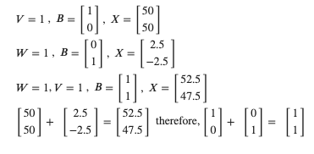
Logic behind the PIDs

Slide 13
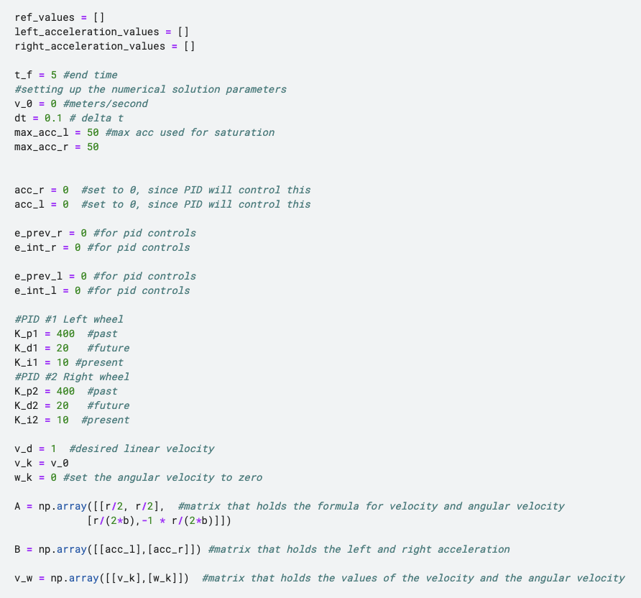
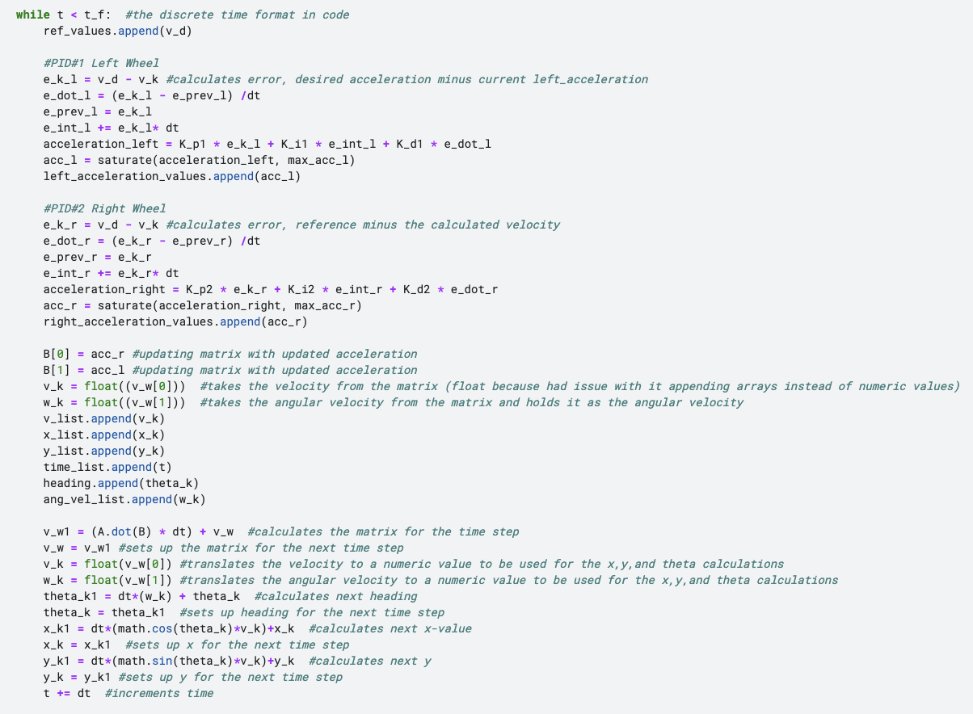
PID Code (not including Plotting):
Notes:
Talk about how we had to do four pids in order to account for the change the linear and angular velocity

Slide 14
PID Examples:
5 Examples:
(where V is the desired velocity and W is the desired angular velocity)
V = 1
W = 1 (Using predicted values from solving the matrix)
W = 1 ( Left Acceleration is 0 but right acceleration is set)
W = 1, V =1 (Using values from #2)
W = 1, V = 1 (Using values from #3)

Slide 15
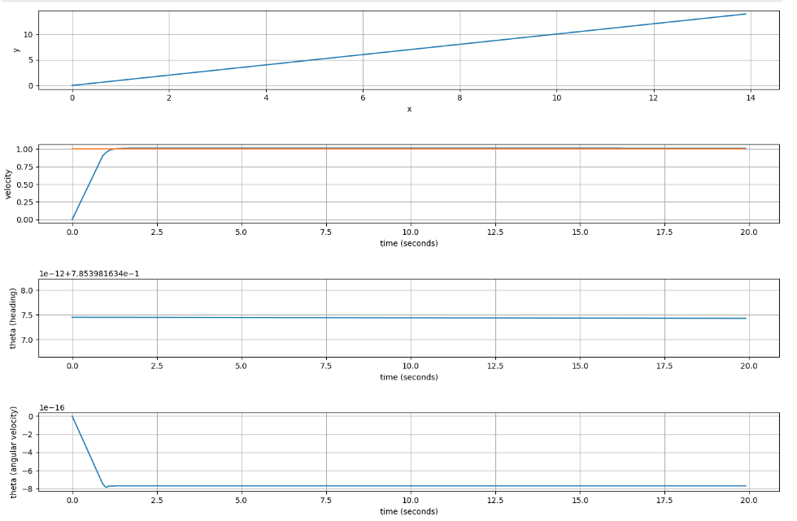
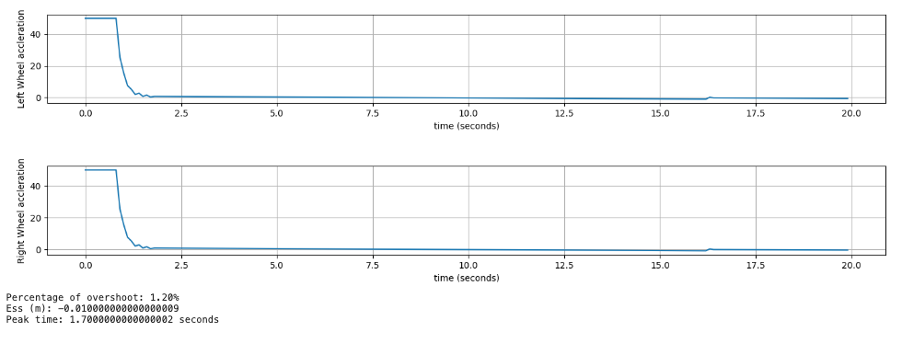
EX #1 :
PID for a linear velocity of 1:

Slide 16
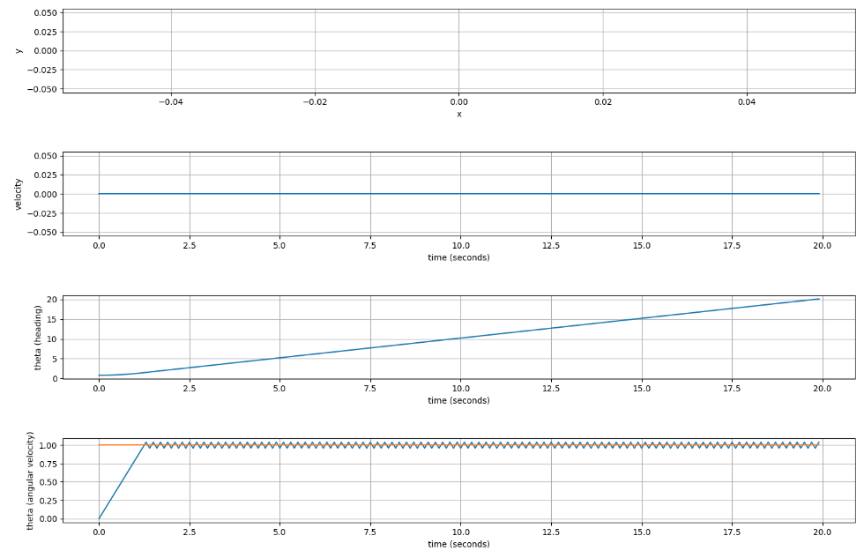
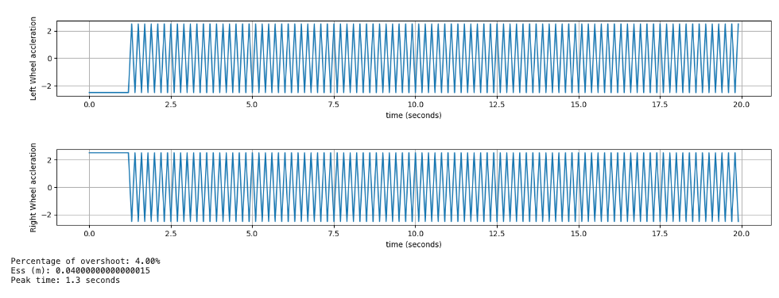
EX #2
PID for W = 1 (Using values from solving the matrix)

Slide 17
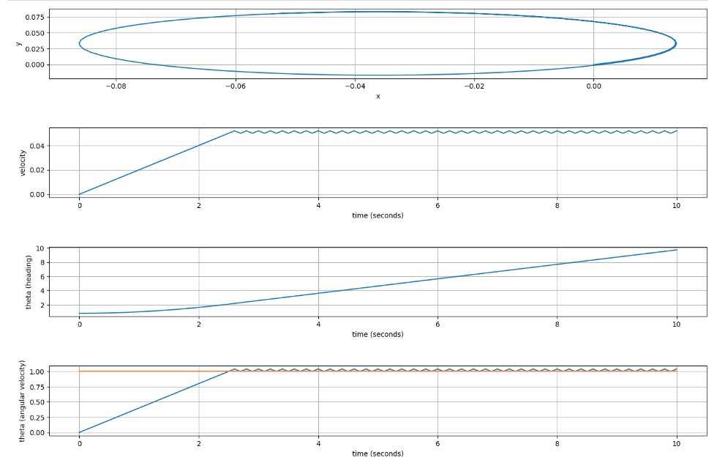
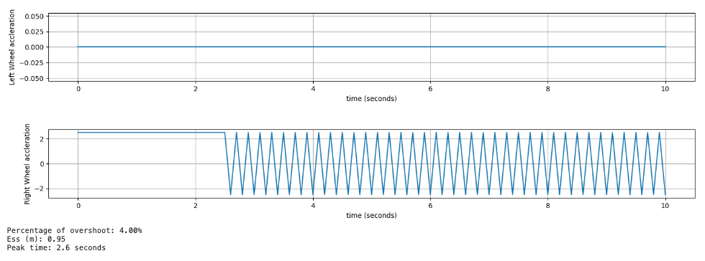
EX #3
PID for W = 1 (Using 0 as the max for left acceleration and 2.5 as the max of the right acceleration)

Slide 18
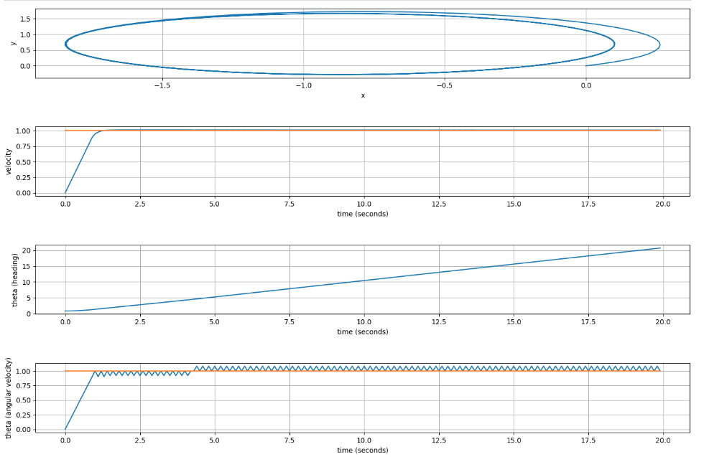
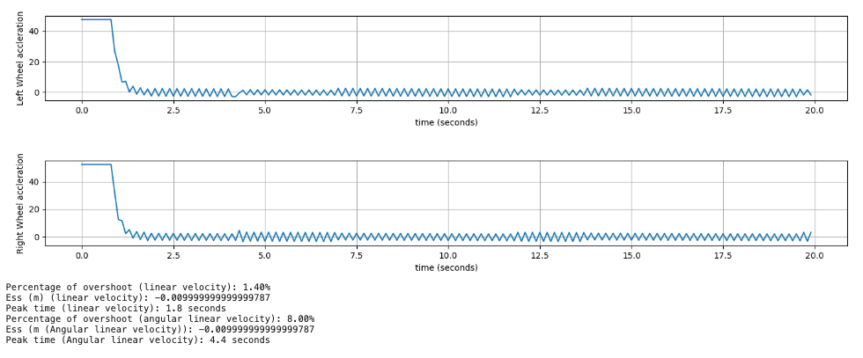
EX#4
PID for V=1 and W = 1 (Using values from solving the matrix for max acceleration values)

Slide 19
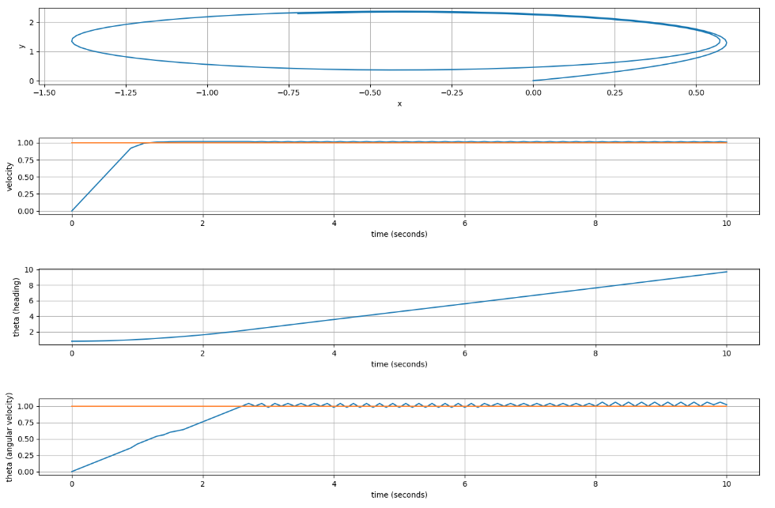
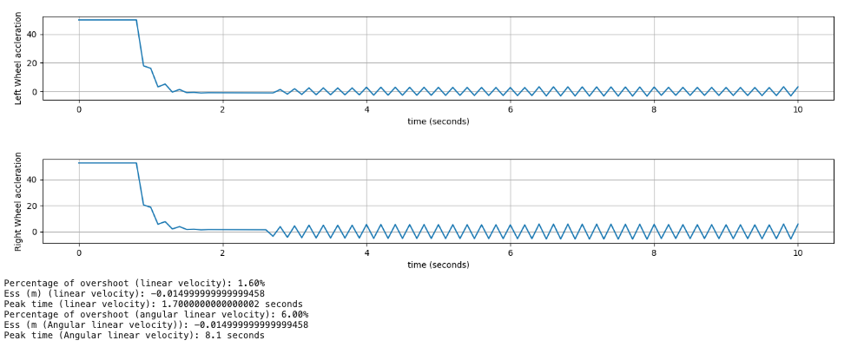
EX #5
PID for V=1 and W = 1 (Using 2.5 for max right acceleration and 0 for max left acceleration)

Slide 20
MPC Controllers Implementation

Slide 21
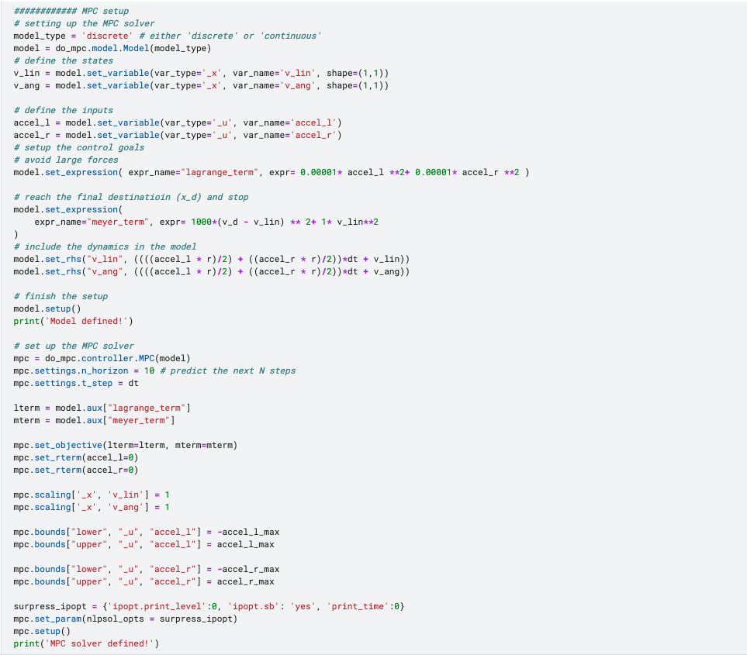
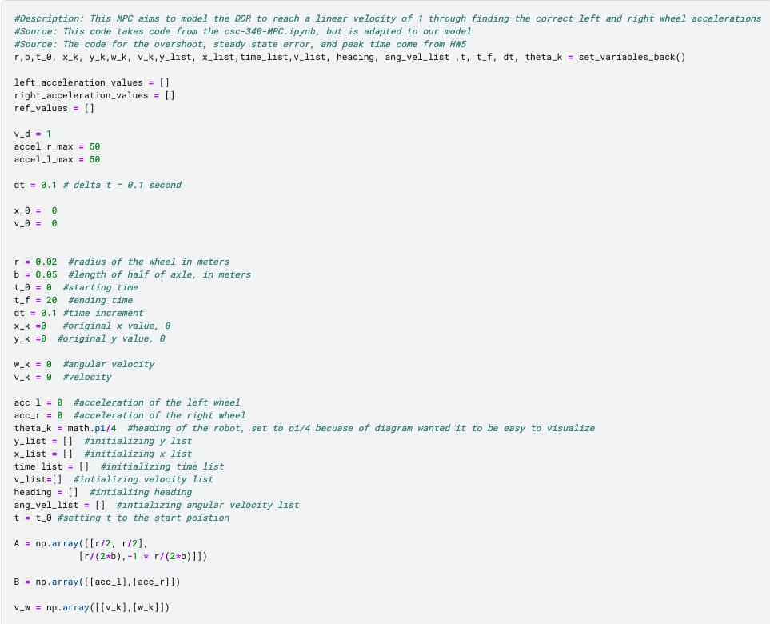
MPC Code (not including Plotting):

Slide 22
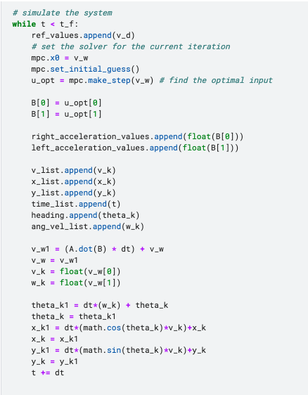
Code Continued…

Slide 23
MPC examples:
4 Examples:
(where V is the desired velocity and W is the desired angular velocity)
V = 1
W = 1 (Using 0 for right acceleration and a value for left acceleration)
V = -1
W = -1 ( Using a value for left acceleration and 0 for right acceleration)

Slide 24
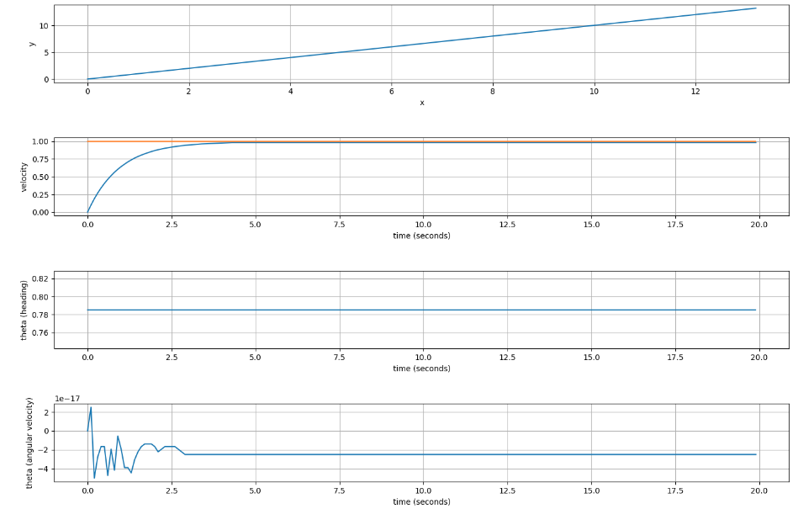
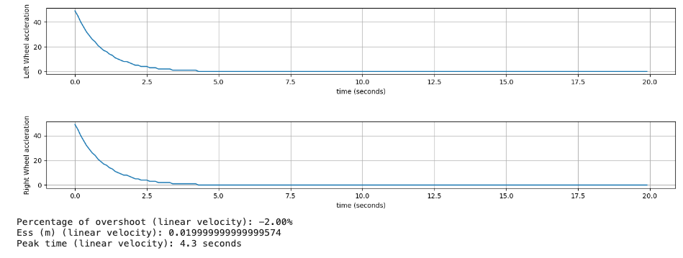
EX #1
MPC for V=1

Slide 25
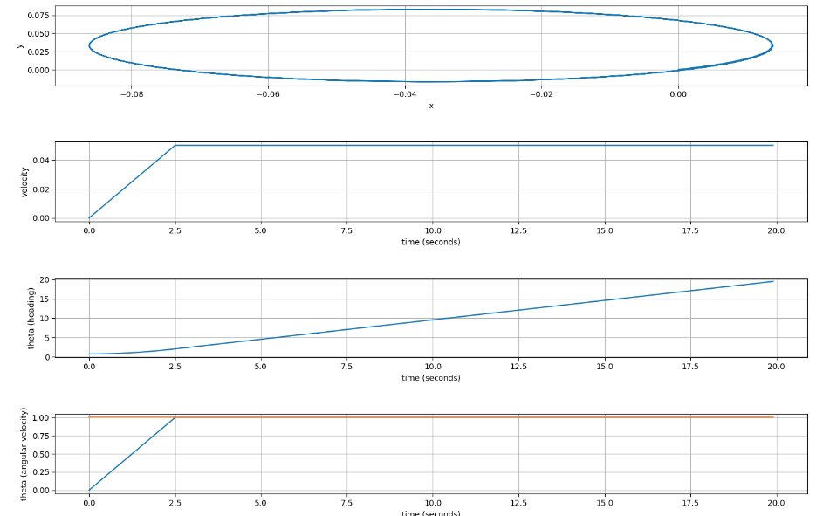
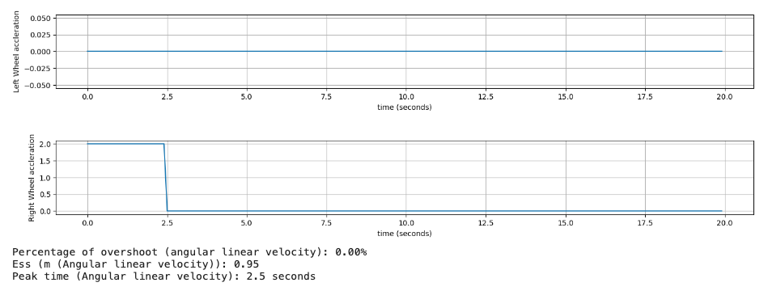
EX #2
MPC for W=1

Slide 26
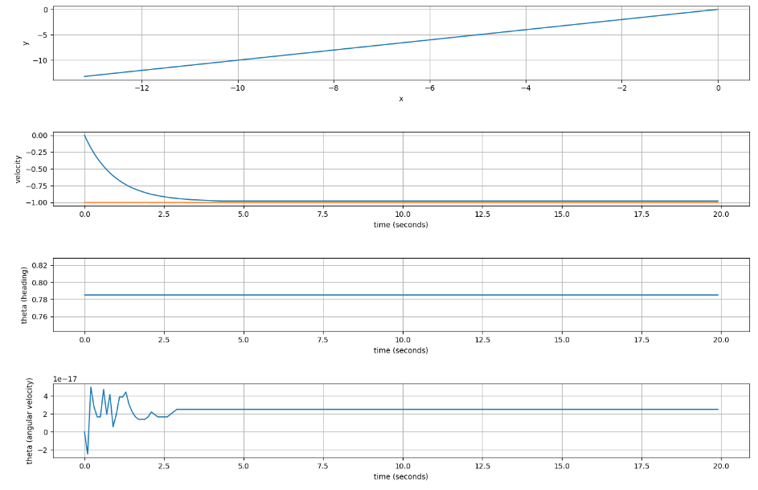
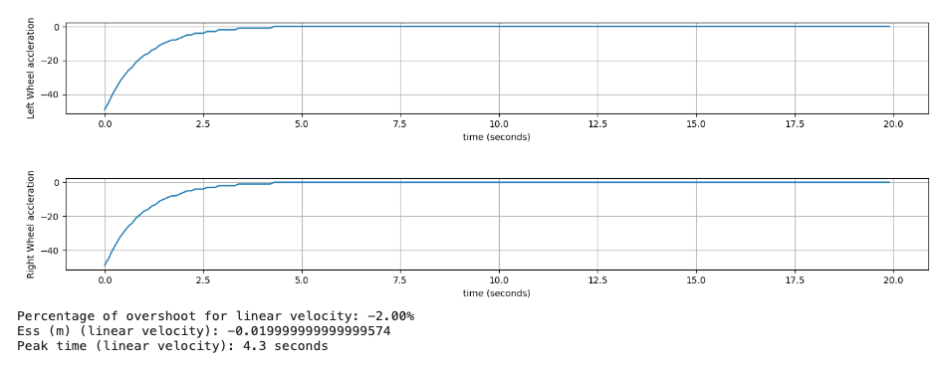
EX #3
MPC for V=-1

Slide 27
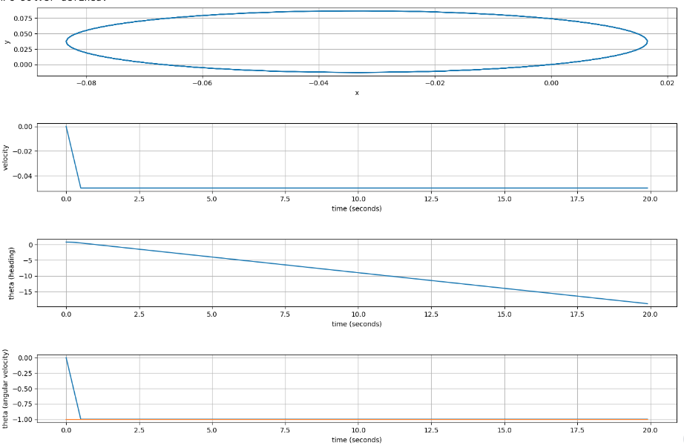
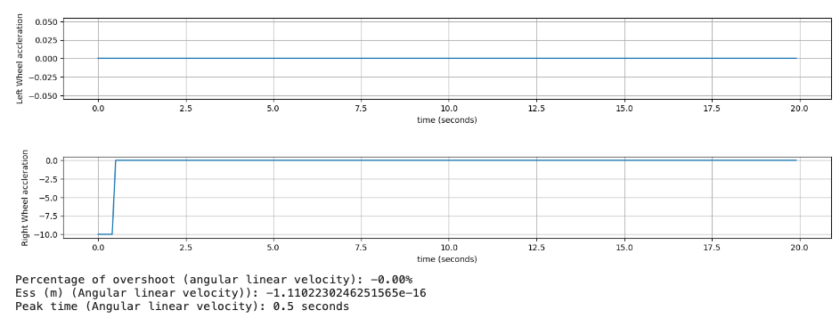
EX #4
MPC for W=-1

Slide 28
Inputs and Outputs
Actuation Devices:
Drive Motors
Motor Controllers
PID Controller
MPC Controller – future behavior prediction
Sensors (In coordination with our real-life examples)
Gyroscope/Accelerometer (Part of IMU)
Proximity Sensors
Inertial Measurement Units (IMUs)
Temperature Sensors (to ensure no overheating)
GPS Modules (Especially DDRs operating outside)
(More possible depending on devices needs)
CONTROLLED Outputs:
Velocity
Position
Heading
Angular Velocity
Inputs:
Speed Values – (Typically in rpm or m/s)
Velocity Values
[12] https://www.wevolver.com/article/sensors-in-robotics-the-common-types

Slide 29
Conclusion for Discrete Time Equation modeling – project 1
Limitations:
Mass is not taken into account
Bumps in terrain are not accounted for
Differences in terrain (rocky, incline/decline, etc.)
Friction of the wheels on the surface slowing the DDR down
Stable Behavior:
Acceleration (due to it remaining the same throughout the experiment)
Unstable Behavior:
Dampening on velocity is not included in our system, therefore; the velocity increases with no limit.

Slide 30
Conclusion for our PID and MPC controllers
MPC appears to be a lot smoother and more accurate.
An MPC is a lot easier to implement since there is no need to adjust the PID values (Kp, Ki, Kd),
The model is extremely limited, considering once the model reaches the target linear or angular velocity it stays at that value.
This makes it hard to model for a positional goal, since the DDR won’t really slow down.
Hard to make a model to reach a desired linear and angular velocity; PIDs might work against each other.
Some improvements that could be made on this model is to have a dampening system on the linear and angular velocity so that the plots appear more realistic . This would allow the wheel accelerations to be constantly changed to a value in order to keep at the target.

Slide 31
Citations
AquaNaut 200 - 2 - Wheel Drive, Pools up to 16’ x 32’. (n.d.).https://hayward.com/aquanaut-200-2-wheel-drive-pools-up-to-16-x-32.html
Lydsto. (n.d.). Lydsto R5 3000PA Self-Cleaning Robot Vacuum & MoP. https://lydsto.com/products/lydsto-r5
Wikipedia contributors. (2023). Arduino. Wikipedia. https://en.wikipedia.org/wiki/Arduino
https://www.amazon.com/perseids-Chassis-Encoder-Wheels-Battery/dp/B07DNXBFQN?th=1
https://microdcmotors.com/product/36mm-12v-24v-dc-rs550-555-motor-high-speed-large-torque-used-for-power-tools
https://42bots.com/tutorials/differential-steering-with-continuous-rotation-servos-and-arduino/
https://www.electricwheelchairsusa.com/products/pride-jazzy-elite-14-front-wheel-drive-power-chair-elite14
https://www.teachengineering.org/lessons/view/cub_mars_lesson02
https://www.youtube.com/watch?v=XG4cODYVbJk
https://www.roboticsbook.org/S52_diffdrive_actions.html
https://blog.pal-robotics.com/omnidirectional-vs-differential-drive-robots/
https://www.wevolver.com/article/sensors-in-robotics-the-common-types
https://en.wikipedia.org/wiki/Differential_wheeled_robot
https://www.techtarget.com/iotagenda/definition/mobile-robot-mobile-robotics#:~:text=While%20the%20industrial%20use%20of,common%20uses%20of%20mobile%20robots.

